Slide 1
Special Matrices and Gauss-Seidel Chapter 11
Credit: Prof. Lale Yurttas, Chemical Eng., Texas A&M University

Slide 2
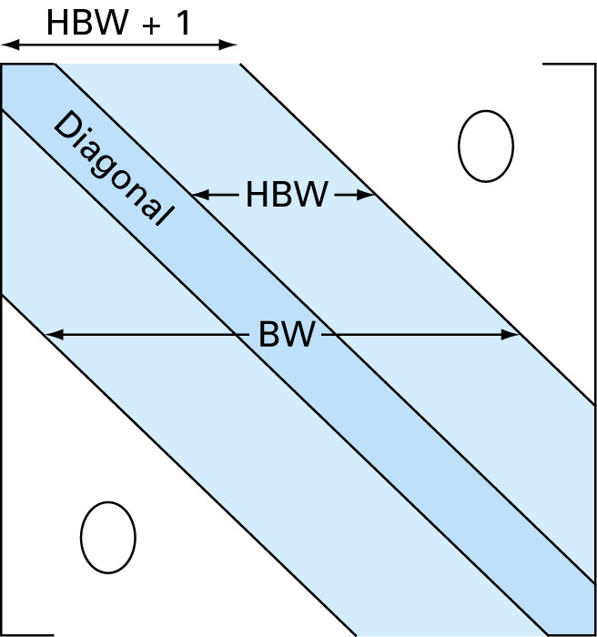
Certain matrices have particular structures that can be exploited to develop efficient solution schemes (e.g. banded, symmetric)
A banded matrix is a square matrix that has all elements equal to zero, with the exception of a band centered on the main diagonal.
Standard Gauss Elimination is inefficient in solving banded equations because unnecessary space and time would be expended on the storage and manipulation of zeros.
There is no need to store or process the zeros (off of the band)

Slide 3
Solving Tridiagonal Systems (Thomas Algorithm)
A tridiagonal system has a bandwidth of 3
DECOMPOSITION
DO k = 2, n
e_{k} = e_{k} / f_{k-1}
f_{k} = f_{k} - e_{k} g_{k-1}
END DO
Time Complexity?
O(n)
vs. O(n³)

Slide 4
Tridiagonal Systems (cont.)
{ d }
Forward Substitution
d₁ = r₁
DO k = 2, n
d_{k} = r_{k} - e_{k} d_{k-1}
END DO
Back Substitution
x_{n} = d_{n} /f_{n}
DO k = n-1, 1, -1
x_{k} = (d_{k} - g_{k} . x_{k+1} )/f_{k}
END DO

Slide 5
Cholesky Decomposition (for Symmetric Positive Definite† Matrices)
† A positive definite matrix is one for which the product
{X}^{T}[A]{X} is greater than zero for all nonzero vectors X
L^{T} means Transpose of L
Time Complexity:
O(n³) but requires half the number of operations as standard Gaussian elimination.

Slide 6
Jacobi Iterative Method
Iterative methods provide an alternative to the elimination methods.
Choose an initial guess (i.e. all zeros) and Iterate until the equality is satisfied.
No guarantee for convergence! Each iteration takes O(n²) time!

Slide 7
Gauss-Seidel
The Gauss-Seidel method is a commonly used iterative method.
It is same as Jacobi technique except with one important difference:
A newly computed x value (say x_{k}) is substituted in the subsequent equations (equations k+1, k+2, …, n) in the same iteration.
Example: Consider the 3x3 system below:
First, choose initial guesses for the x’s.
A simple way to obtain initial guesses is to assume that they are all zero.
Compute new x₁ using the previous iteration values.
New x₁ is substituted in the equations to calculate x₂ and x₃
The process is repeated for x₂, x₃, …

Slide 8
Convergence Criterion for Gauss-Seidel Method
Iterations are repeated until the convergence criterion is satisfied:
For all i, where j and j-1 are
the current and previous iterations.
As any other iterative method, the Gauss-Seidel method has problems:
It may not converge or it converges very slowly.
If the coefficient matrix A is Diagonally Dominant Gauss-Seidel is guaranteed to converge.
Diagonally Dominant ➔
Note that this is not a necessary condition, i.e. the system may still have a chance to converge even if A is not diagonally dominant.
Time Complexity: Each iteration takes O(n²)

